Slide 1


Serverless Holiday Hackathon 2023

Slide 2



Our plans for today
About Serverless Guru
Bedrock Code Samples
Building Our Own AI Chatbot
Q & A

Slide 3
About Serverless Guru
Your Guide to Serverless Adopt. Migrate. Build.

Slide 4
Our Company
We love to take on challenges, face the unknown, and be on the forefront of serverless innovation.
Helping companies and people realize their full potential gives us energy.
Speak to a Guru today!

Slide 5
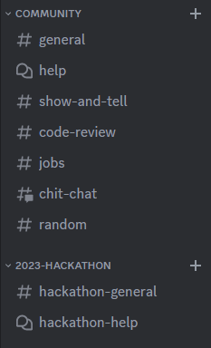
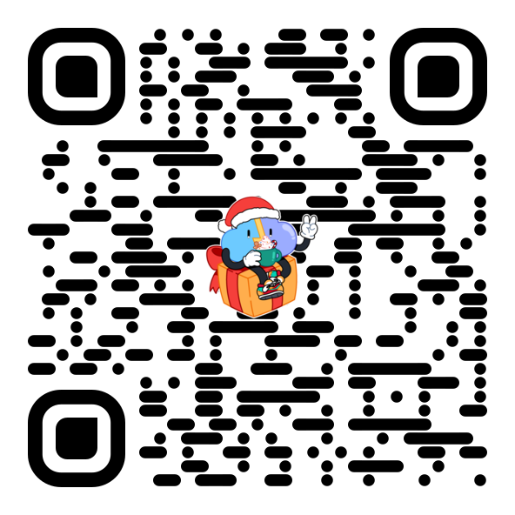
Join our discord Server!

Slide 6
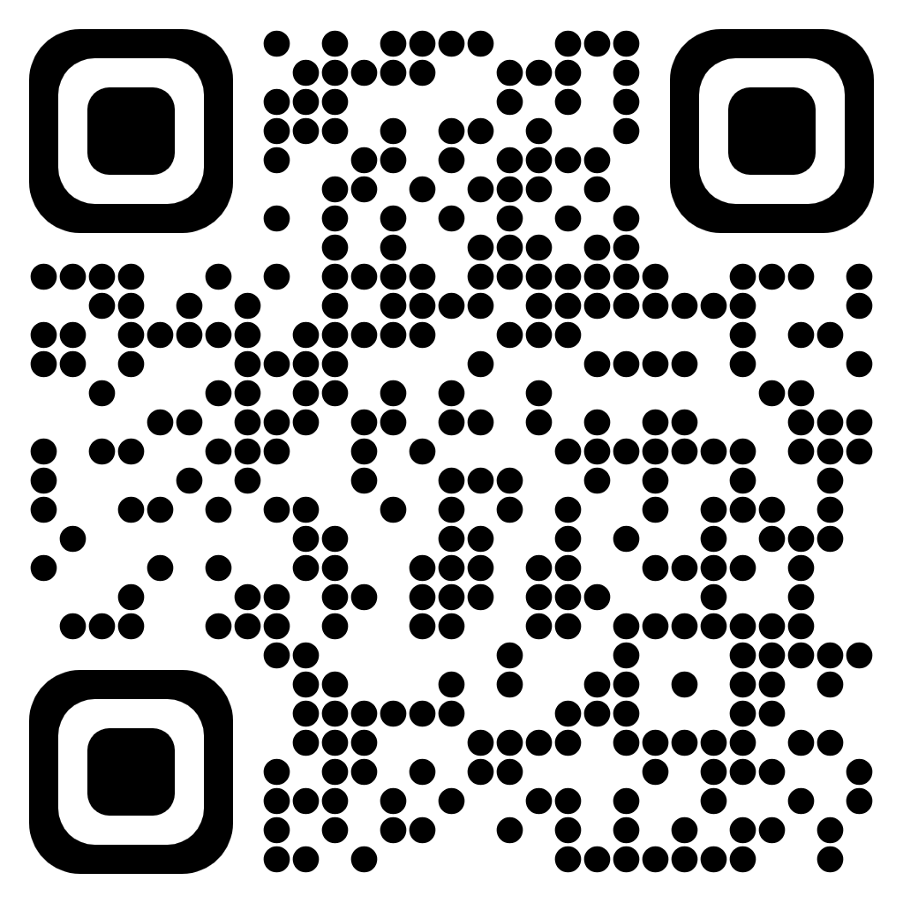
Submission Requirements
Submit your project
Deadline December 17, 2023, 11:59 PM PST Any change made after the deadline won’t be reviewed
What is required?
Link to Article: Published Article link (Hashnode, Medium, dev.to, …)
Link to Demo Video: Has to be accessible via public link (Youtube, Loom, …)
Link to Public Repository: Repository has to be public and visible by anyone
Any additional comments, f.e.: the link to hosted app, any required credentials, …

Slide 7
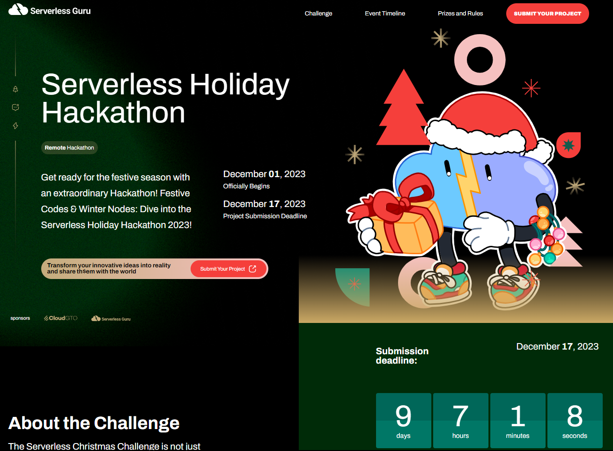
Submissions Form

Slide 8
Bedrock Code Samples
Examples to get started using AWS Bedrock with or without Langchain

Slide 9
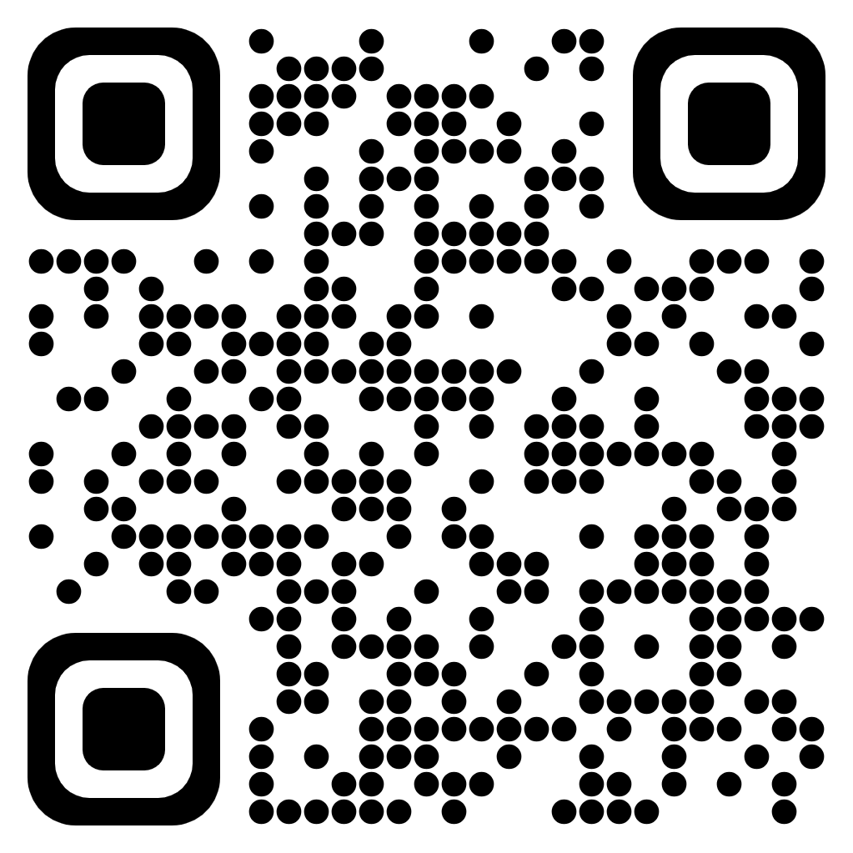
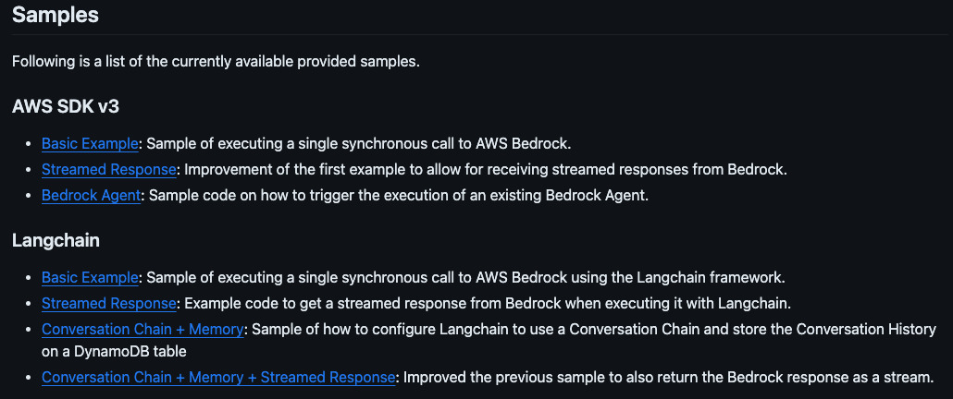
Bedrock Code Samples

Slide 10
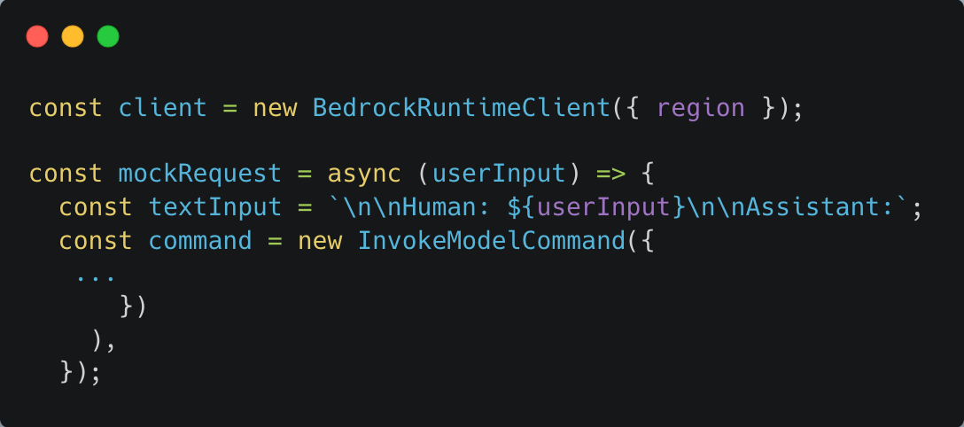
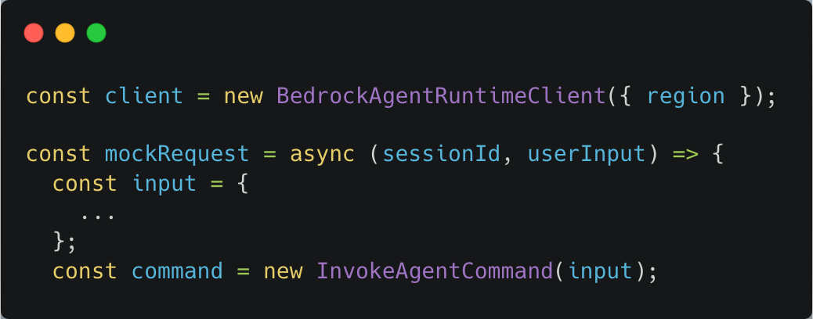
Bedrock Code Samples
Preserve Conversation?

Slide 11
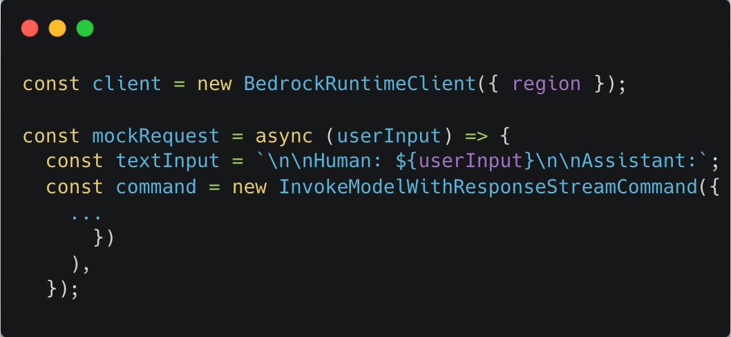
Bedrock Code Samples
Streamed Response?

Slide 12
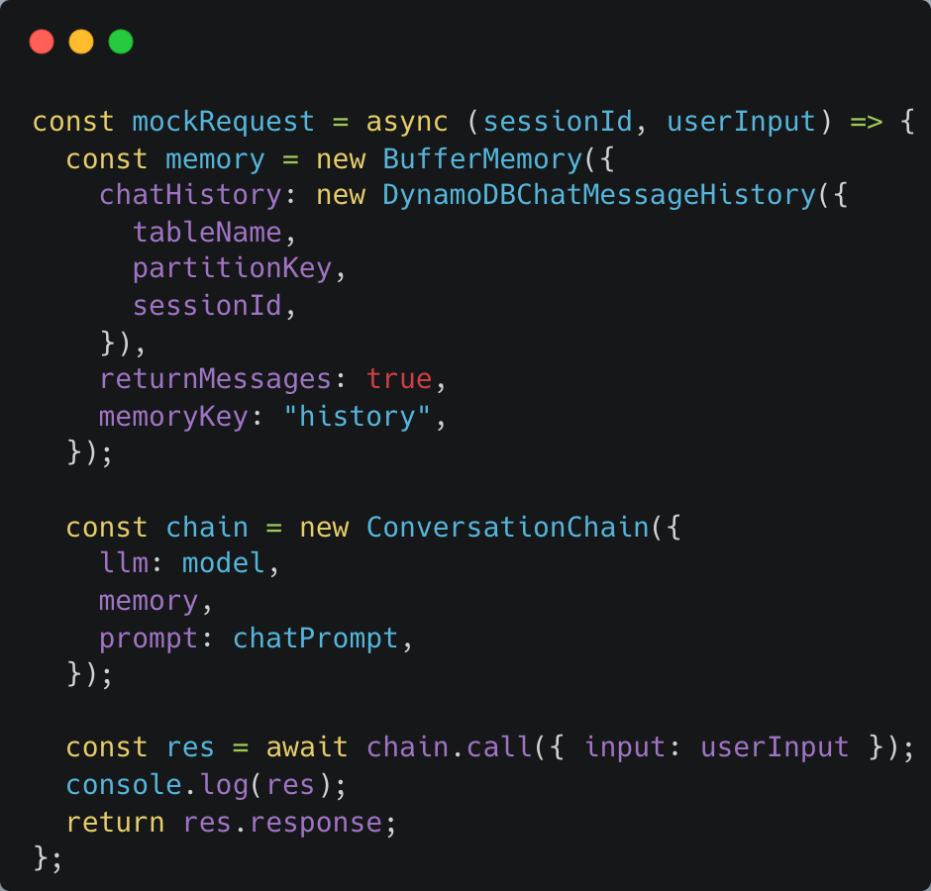
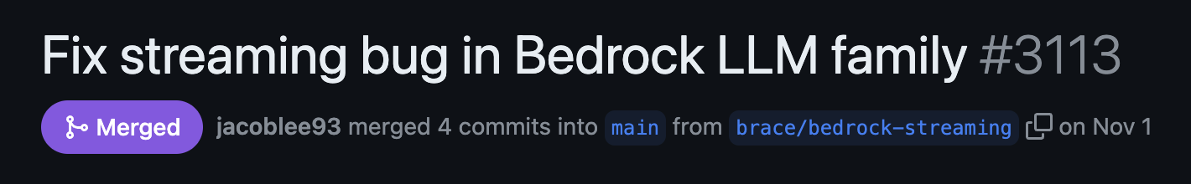
Bedrock Code Samples
Lang* vs AWS Ecosystem?
Notes:
LangSmith
LangServe Don’t forget popup of PR for github issue

Slide 13
Demo!
Check out our very own Santa Chatbot

Slide 14
Building Our Own AI ChatBot
Check out ho ho how we built our very own Santa Chatbot

Slide 15
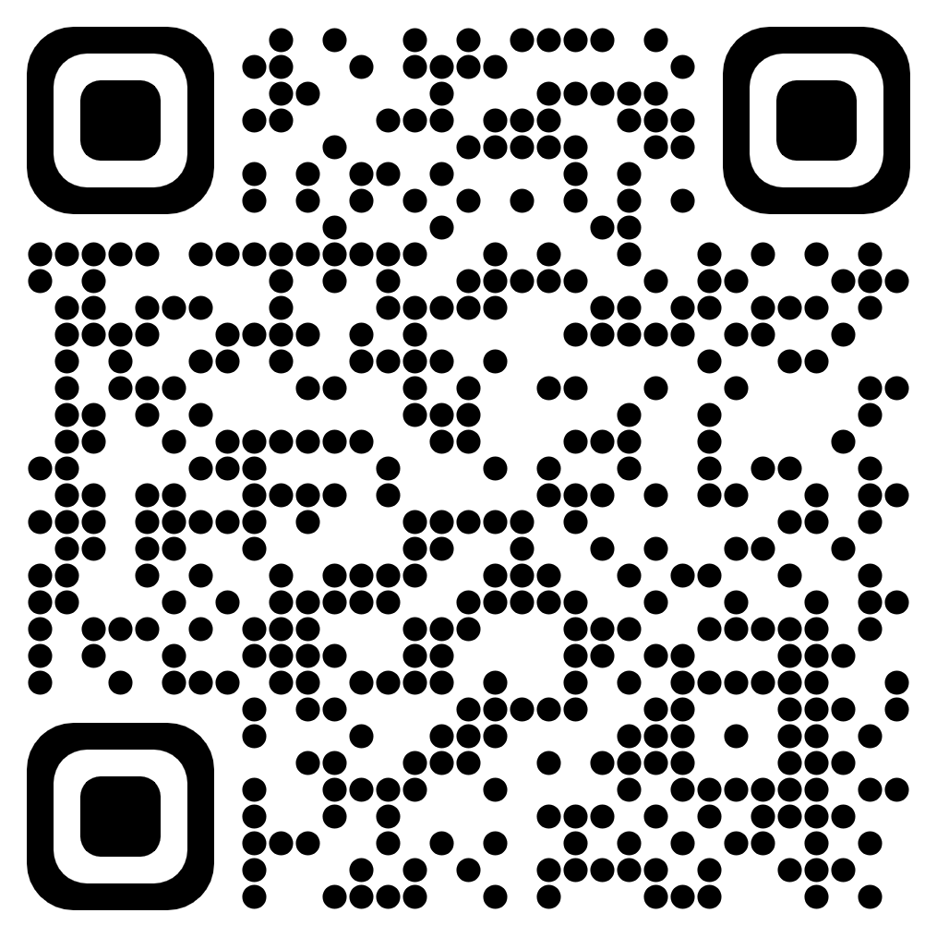
Challenges Faced
Overview
Implementing LLMs
Conversation Memory
Streamed Responses
WebSocket API
Decoupling long-lasting execution
Authentication and State Management

Slide 16
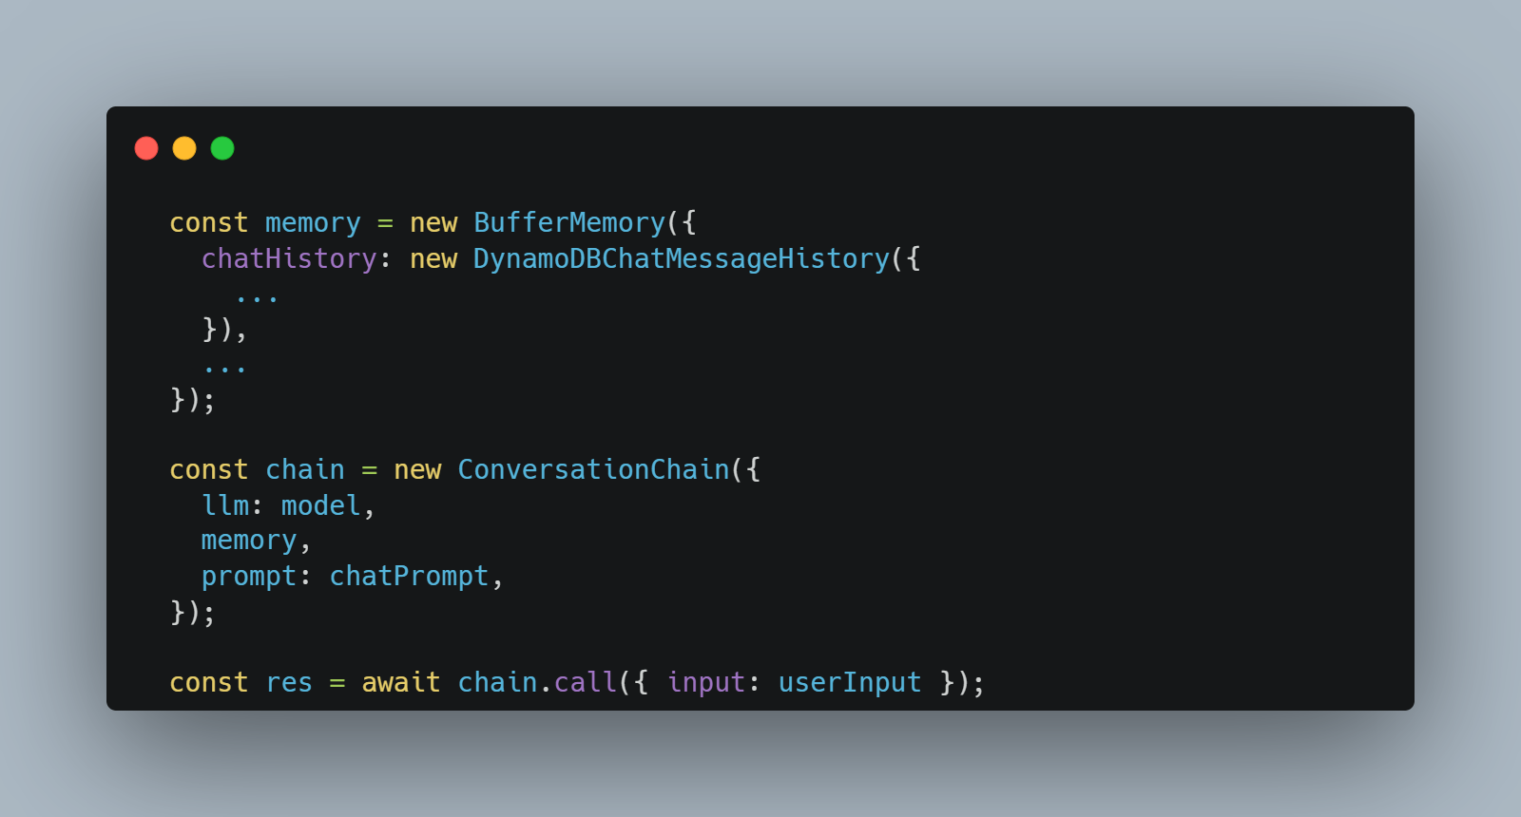
Challenges Faced - LLM
Conversation Memory

Slide 17

Challenges Faced - LLM
Streamed Responses

Slide 18
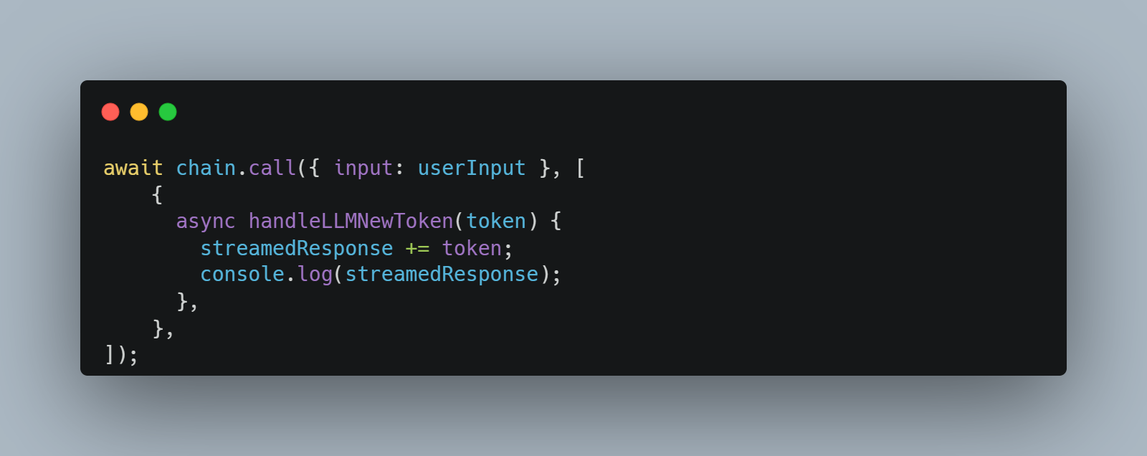
Challenges Faced - LLM
Streamed Responses

Slide 19
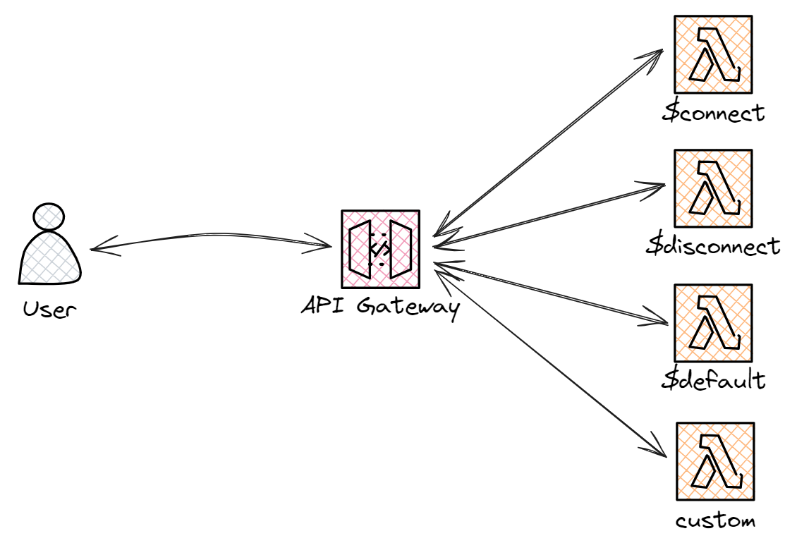
Challenges Faced - WebSocket
Decoupling long-lasting execution

Slide 20
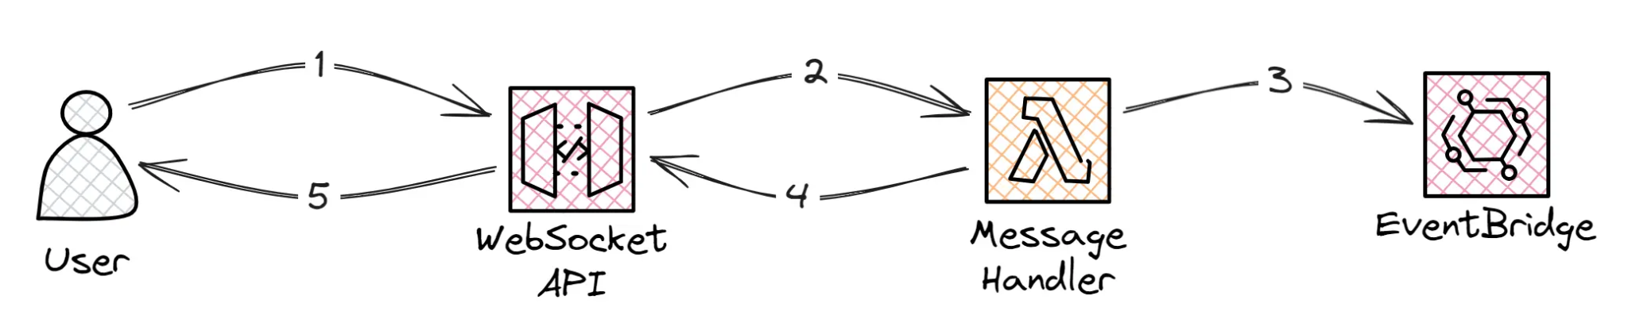
Challenges Faced - WebSocket
Decoupling long-lasting execution

Slide 21
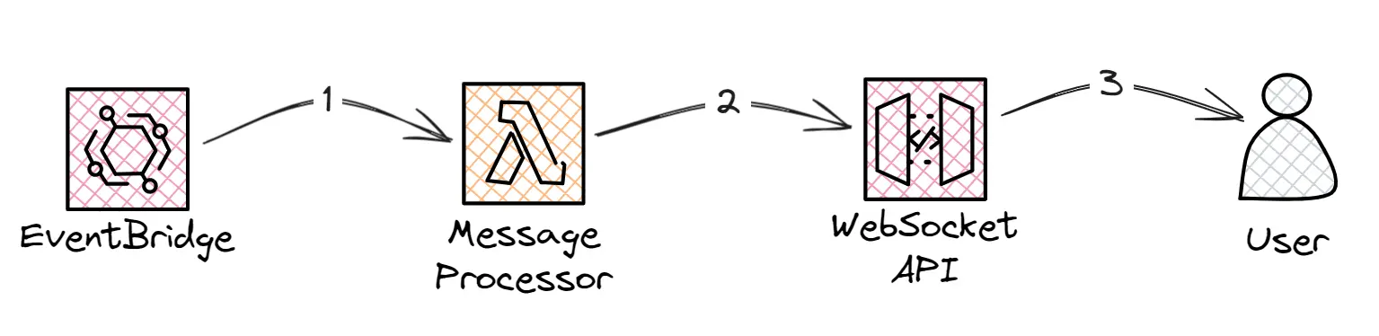
Challenges Faced - WebSocket
Decoupling long-lasting execution

Slide 22
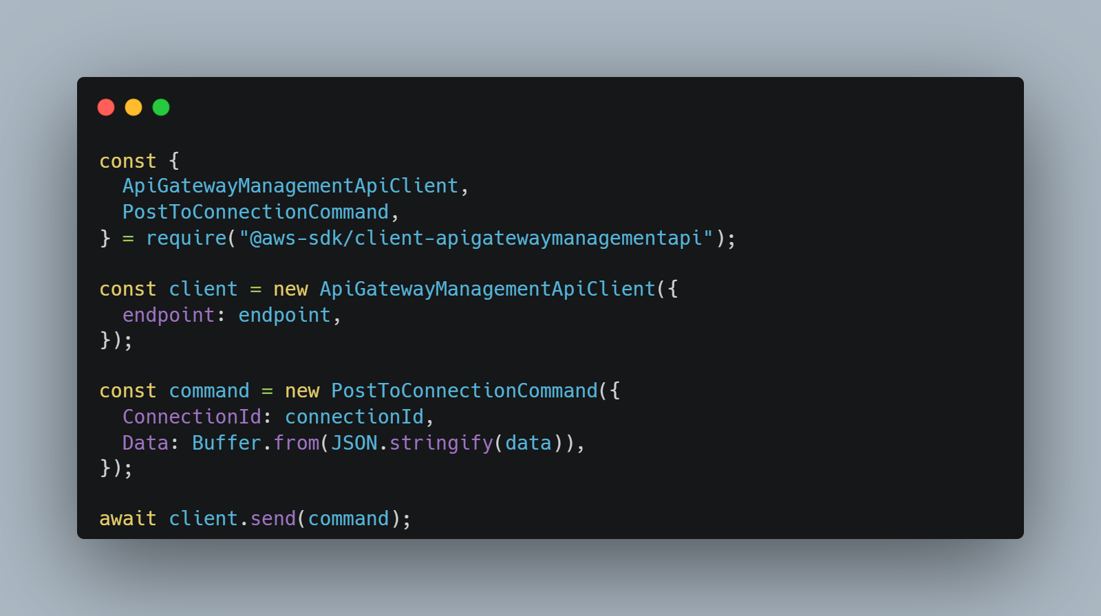
Challenges Faced - WebSocket
Decoupling long-lasting execution

Slide 23
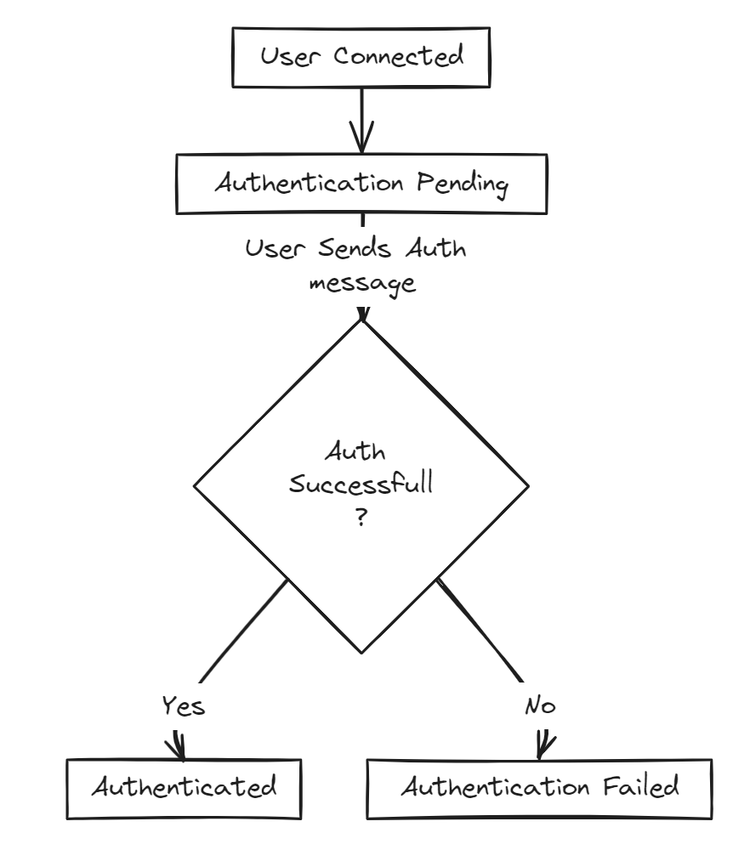
Challenges Faced - WebSocket
Authentication and State Management

Slide 24
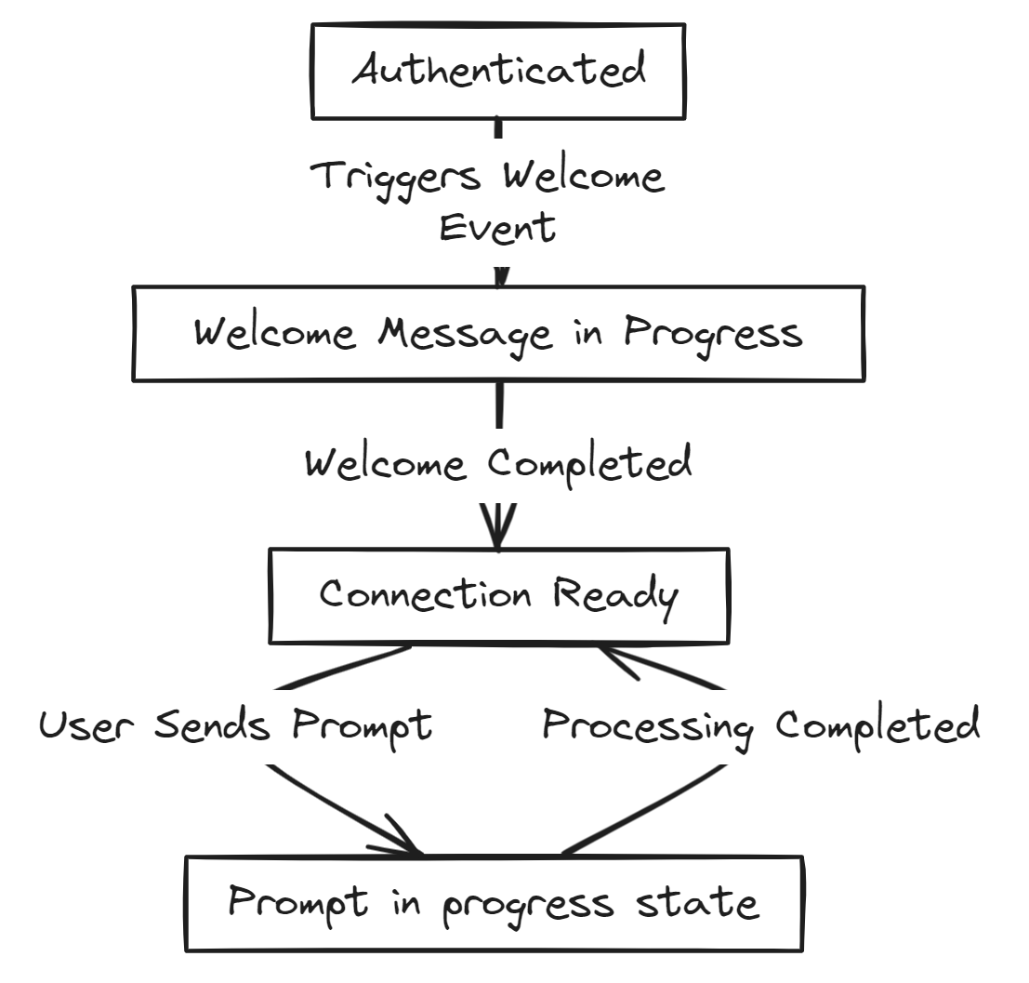
Challenges Faced - WebSocket
Authentication and State Management

Slide 25
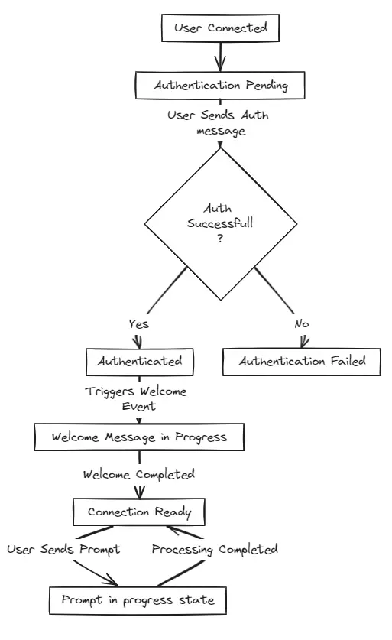
Challenges Faced - WebSocket
Authentication and State Management

Slide 26
Architecture Overview
Overview
Management API
WebSocket API
Default Actions
Custom Actions
Decoupled Events

Slide 27
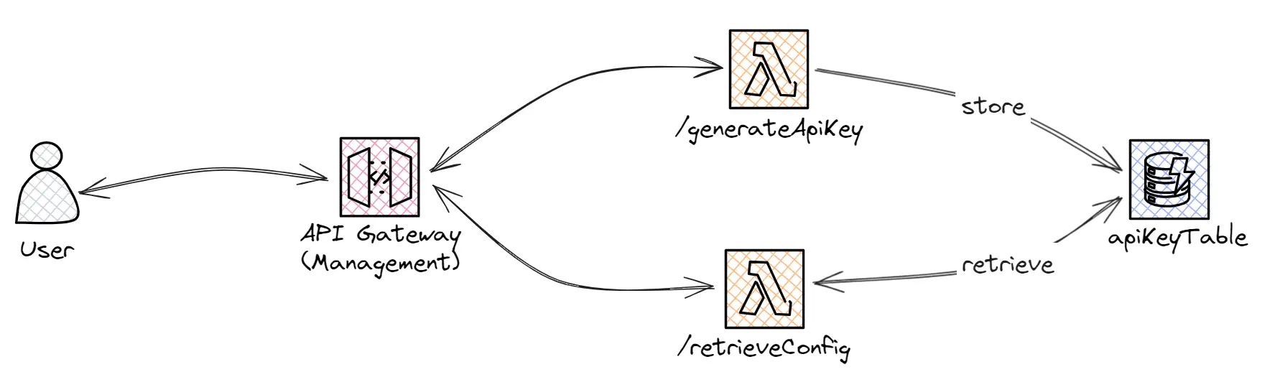
Architecture Overview
Management API

Slide 28
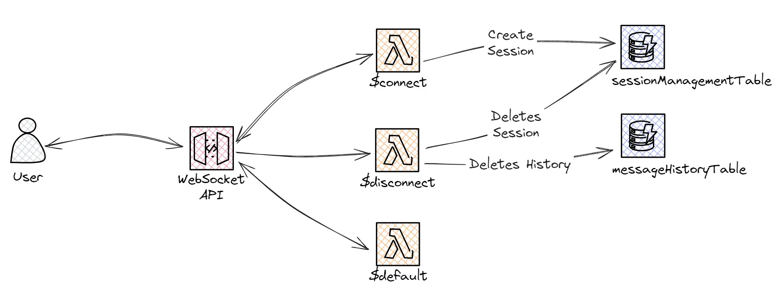
Architecture Overview
WebSocket API - Default Actions

Slide 29
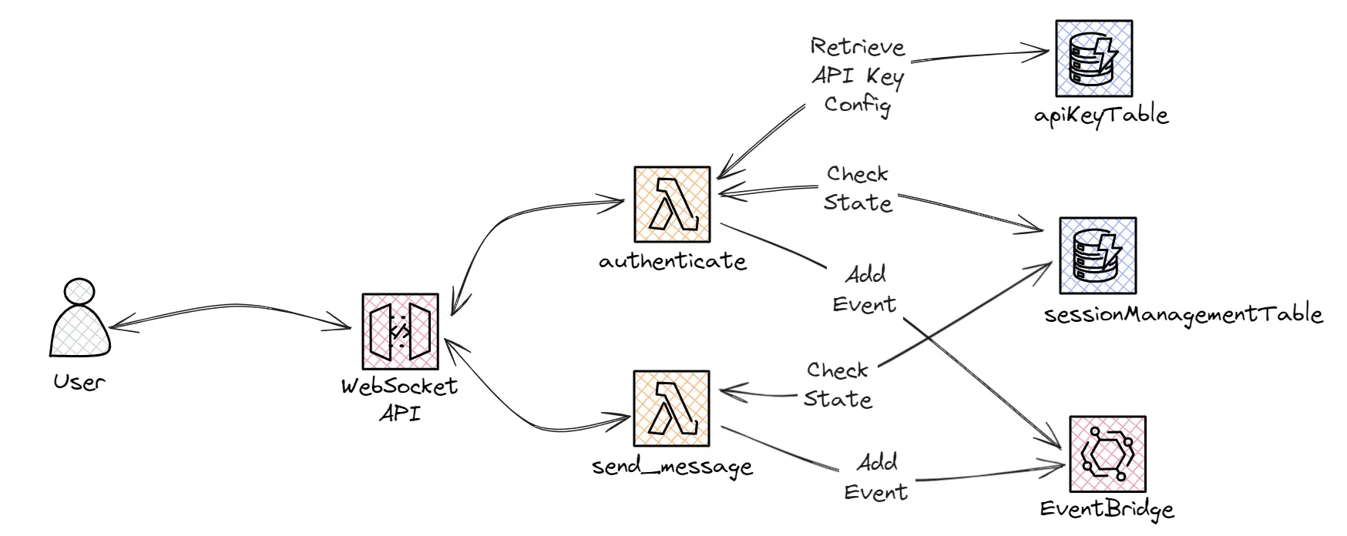
Architecture Overview
WebSocket API - Custom Actions

Slide 30
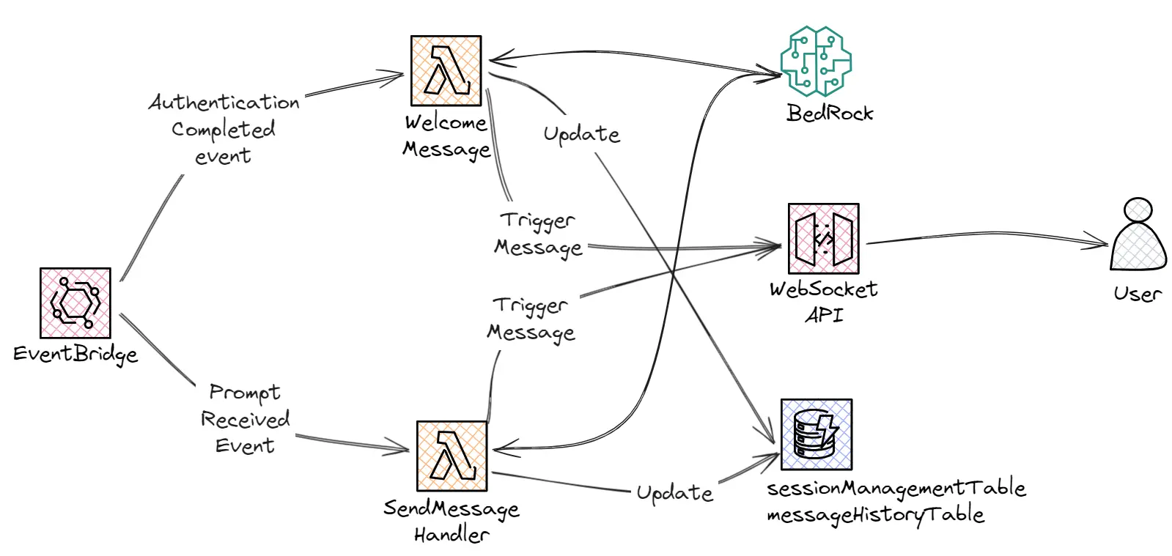
Architecture Overview
WebSocket API - Decoupled Events

Slide 31
Future Work
Possible Improvements
Enable voice-to-text and text-to-voice transcription to take the application a step further and make it feel more like a real conversation and not just a chat.
Improve Authentication and allow for persistent message history.
Add any additional features, such as implementing an Agent to allow the LLM to query another API to f.e.: List possible gift ideas or build a custom wishlist to send to Santa.

Slide 32
Questions & Answers
We are here to help!
Raise any questions or concerns you might have

Slide 33
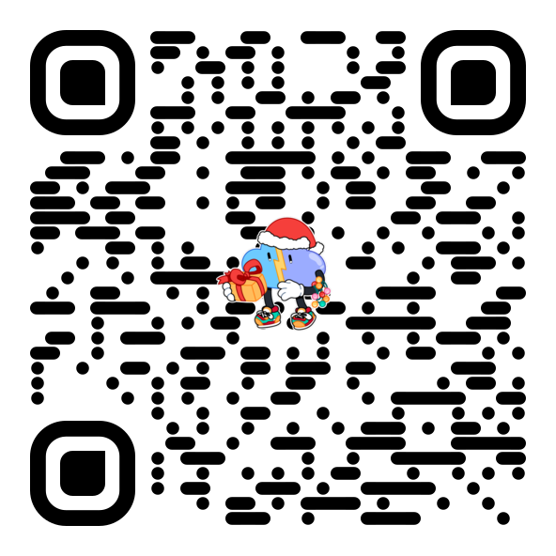
Thank you!
Join our discord Server!
Submit your Project!

